Slide 1
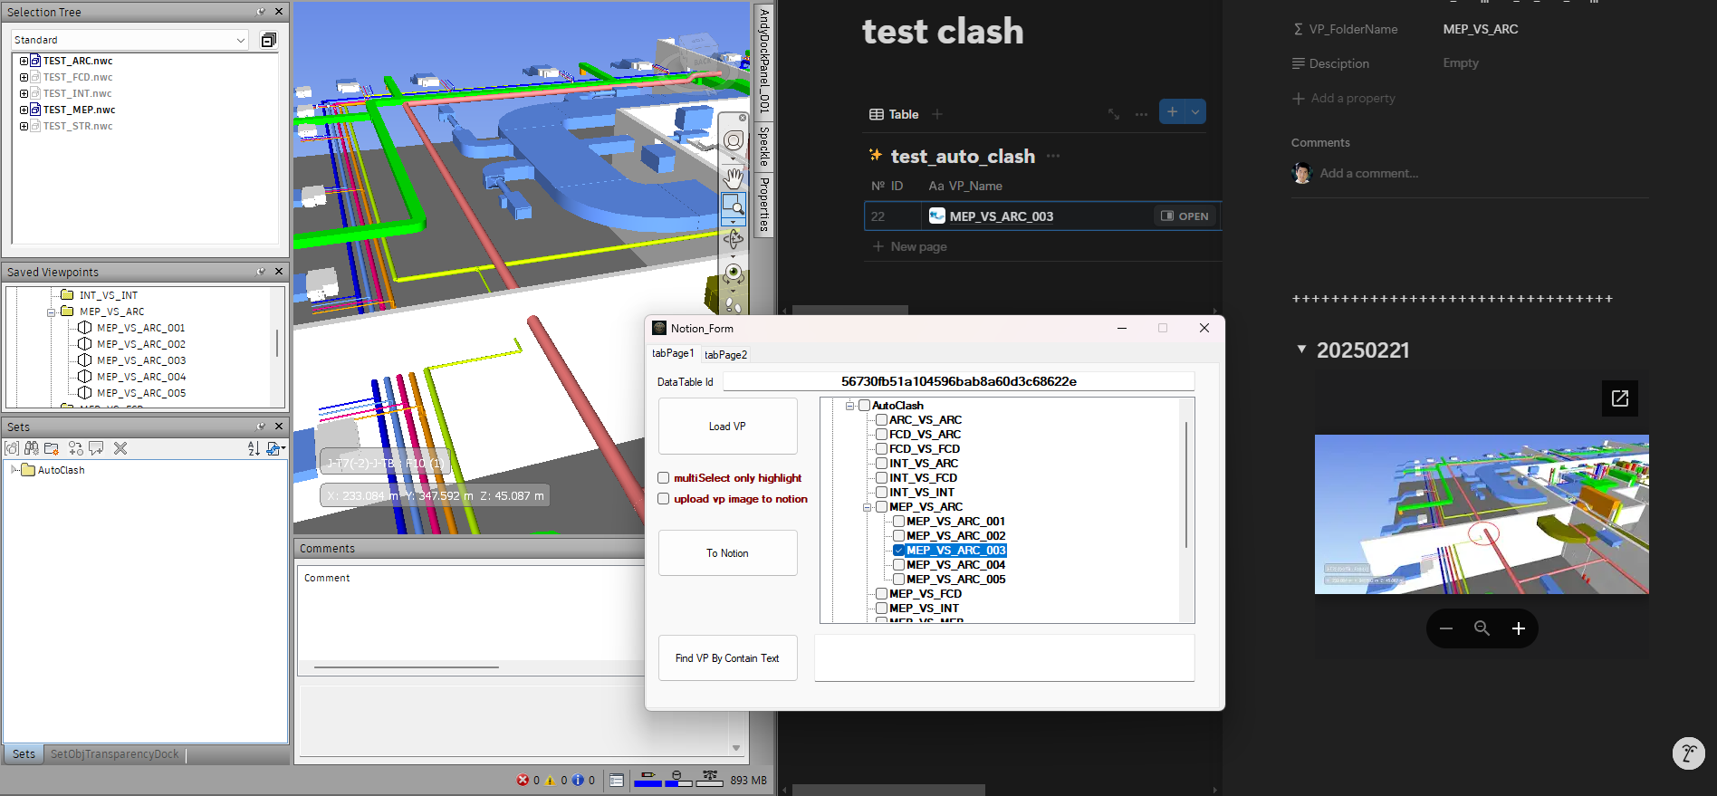
Navis Plugin - Clash Management On Notion AI DOC Platform
Application No: 1300053882
This solution enhances clash management by integrating directly with the Notion platform, enabling cloud-based clash documentation. Users can view viewpoint images of issues in the cloud, with this solution Notion can automatically recording details like viewpoint names, comments, IDs, upload times, statuses, and viewpoint folder names. Additionally, custom properties or screenshots of drawings can be added to improve engineers' understanding. This online approach overcomes the limitations of traditional clash reports in Excel or Word, offering a more dynamic, accessible, and comprehensive way to manage and review clashes efficiently.

Slide 2
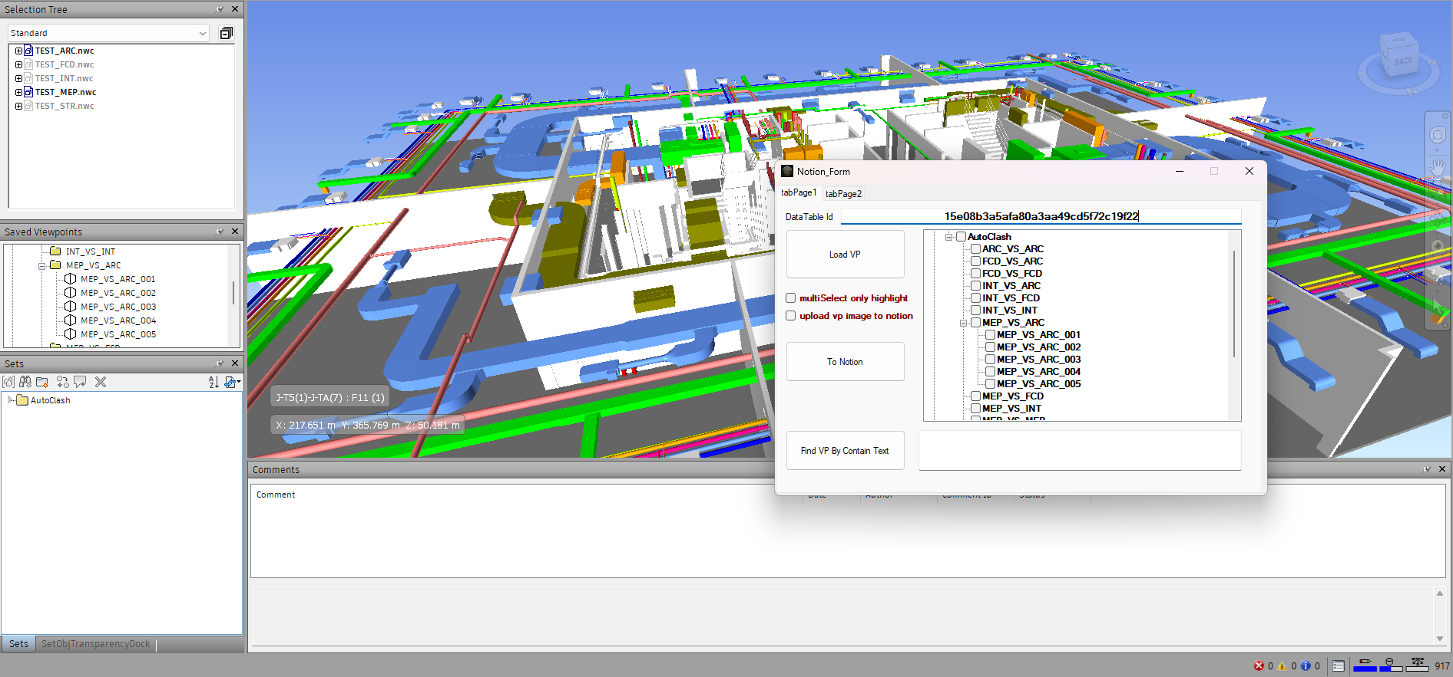
Navis Plugin - Clash Management On Notion AI DOC Platform
Application No: 1300053882
The plugin can load viewpoints from Navisworks, and double-clicking the viewpoint name in the plugin can directly activate the viewpoint, enabling interaction with Navisworks.

Slide 3
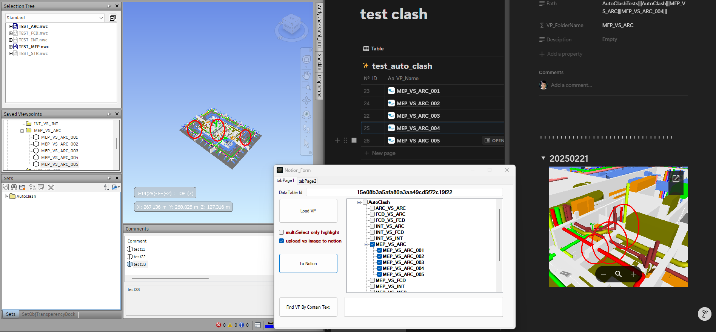
Navis Plugin - Clash Management On Notion AI DOC Platform
Application No: 1300053882
After selecting the issue viewpoints which we want to sync, clicking "To Notion" will synchronize the viewpoints from Navisworks to Notion.

